Slide 1
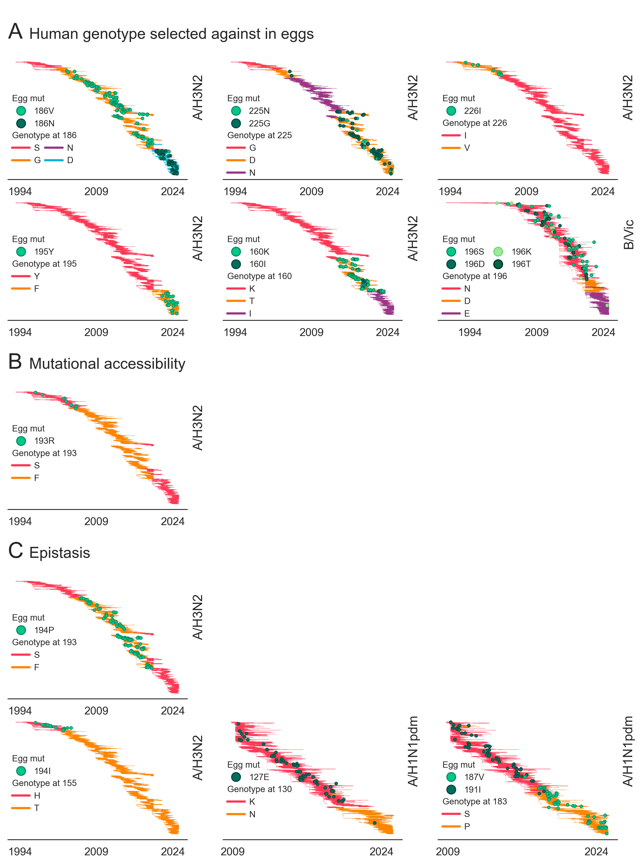
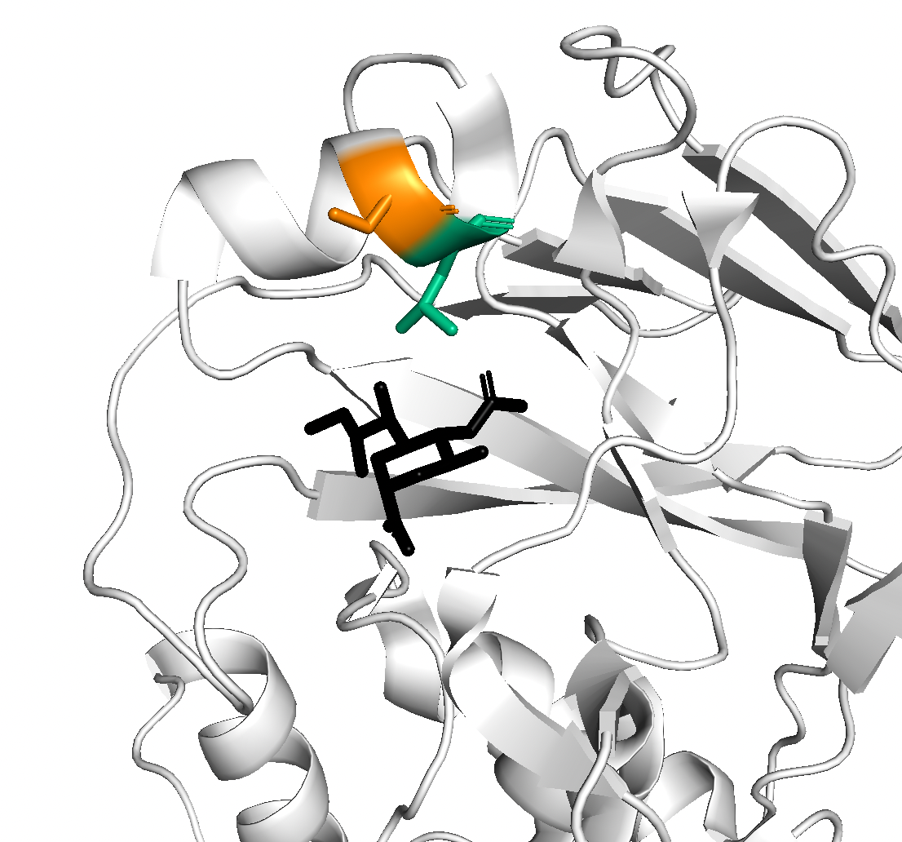
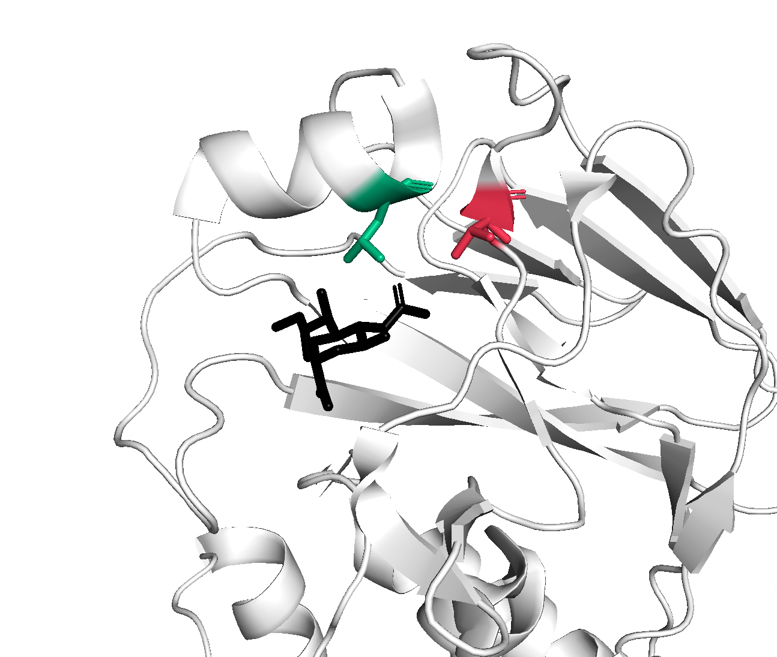
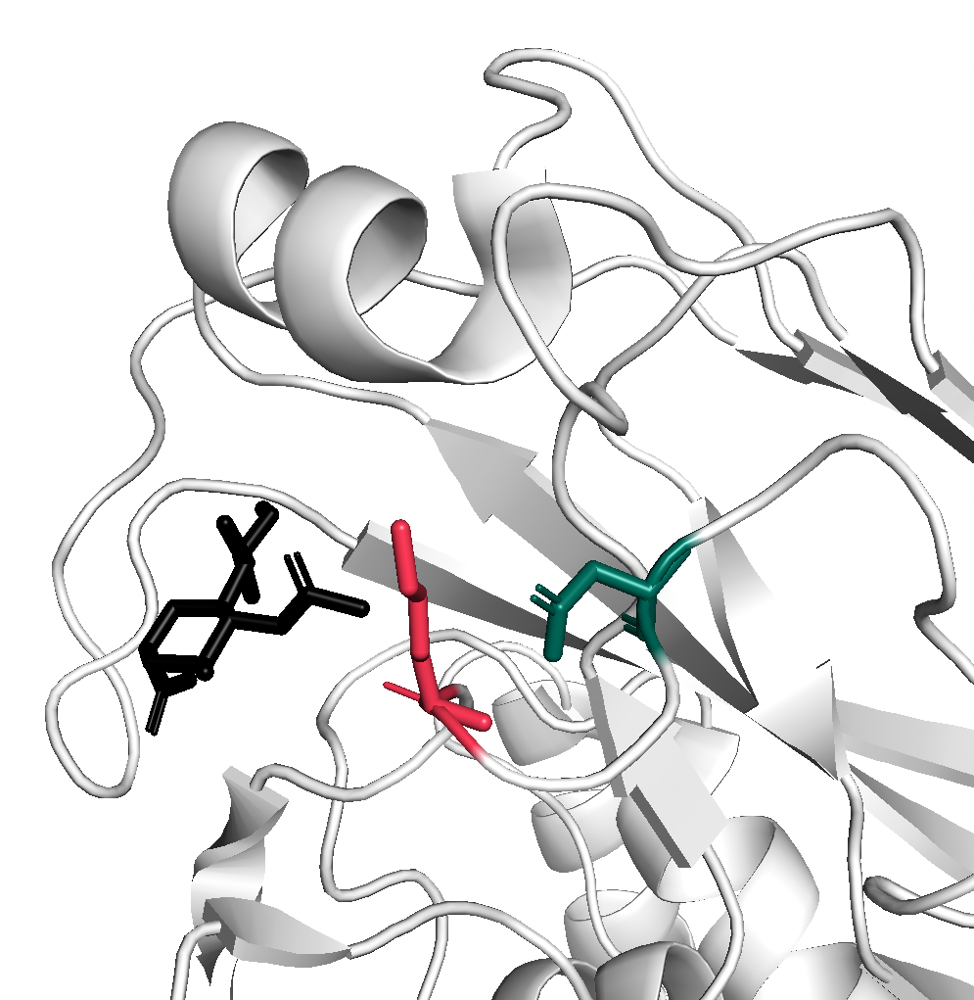
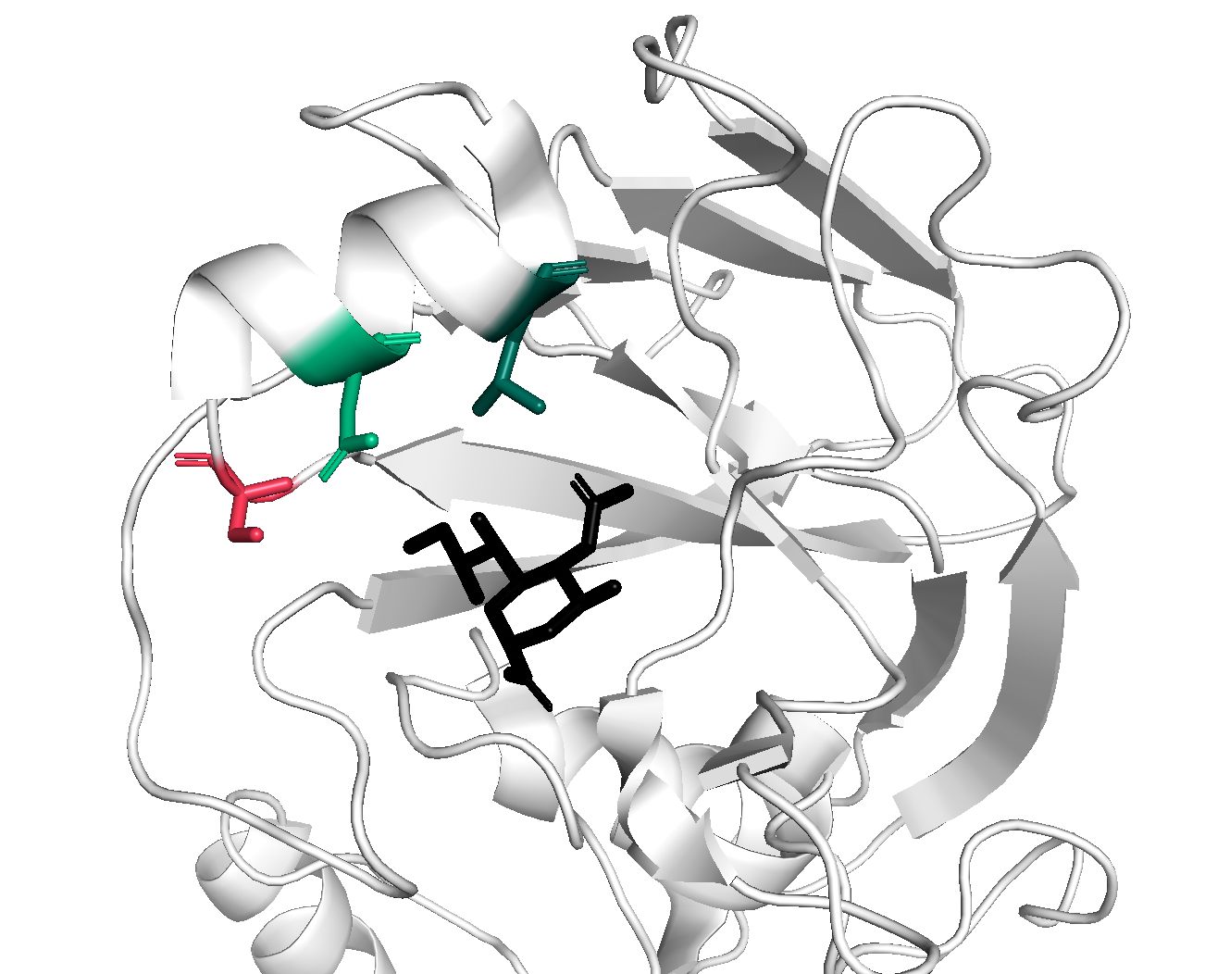
S = AGC
1 step to R
A/H3N2
193
194
A/H3N2
155
194
F = TTC
2 steps to R
S = TCC
2 steps to R
A/H1N1pdm
130
127
A/H1N1pdm
183
187
191

